Slide 1
IFSWF Subcommittee #2 Case Study #3: Constructing Portfolios for Specific Macroeconomic Environments

Slide 2
Case study objectives
To construct investment portfolios that are resilient to specific macroeconomic environments -- such as market turbulence or high inflation -- without giving up too much return on balance over the long term.
To identify solutions that could be useful to the broadest possible set of SWFs, while recognizing that each SWF has unique challenges, constraints, and objectives and that as such, no single approach will be appropriate for all SWFs.

Slide 3
Questions for discussion
Is it important for SWFs to manage interim losses during turbulent periods? If so, what is the appropriate tradeoff between this resilience and long-term performance?
Turbulence is just one type of market environment. For what other types of environments should SWFs prepare – and what are the best methods for doing so?
How tactical should SWFs be in managing their asset allocations? What are the risks and benefits?
Quantitative tools should always be used as a complement to sound judgment and never as a substitute for it. What are the important qualitative aspects of portfolio construction?

Slide 4
Outline
Is portfolio optimization dead? - We present a brief review of mean-variance optimization, evaluate common critiques of the technique, and introduce a useful alternative approach.
Risk, regimes, and performance - We define market turbulence, show how to partition historical returns into turbulent and quiet periods, and examine the link between turbulence and performance.
Case study: from theory to practice - We introduce a framework that an SWF could employ to construct a portfolio that is more resilient to turbulent markets without giving up too much return on balance over the long term.

Slide 5
Is portfolio optimization dead?

Slide 6
Mean-variance optimization: a brief review
Mean-variance optimization was originally proposed by Harry Markowitz in 1952, but it was not until the mid 1970s that institutional investors seriously embraced the technology.*
For a given set of asset class inputs (expected return, risk, and correlation), MVO identifies the allocation that offers the highest expected return for a given level of risk – or the lowest risk for a given level of expected return.
A continuum of optimal portfolios forms the efficient frontier, which extends from the minimum-risk portfolio (lower left) to a portfolio that is 100% invested in the asset with the highest expected return (upper right).
Most institutional investors conduct asset allocation studies every three to five years to reevaluate the efficiency of their portfolios. Most employ some form of mean-variance optimization as part of this review.
*Source: Kritzman, Mark. “The Graceful Aging of Mean-Variance Optimization.” The Journal of Portfolio Management, Winter 2011.

Slide 7
The efficient frontier with stocks and bonds
Minimum-risk portfolio
5% stocks, 95% bonds
*This illustration assumes that for stocks and bonds , respectively, expected returns are 9% and 6%, standard deviations are 20% and 5%, and correlation is zero.

Slide 8
Evaluating common critiques of MVO*
Critique: Garbage in, garbage out - if the inputs to MVO are incorrect then the “optimal” weights will also be incorrect.
Response: This is true. But why should we hold MVO to a higher standard than calculators, spreadsheets and cooking recipes?
Critique: MVO is an “error maximizer” – the weights in the optimal portfolio are hypersensitive to small errors in the inputs.
Response: This is only true when assets are close substitutes for one another (i.e., when they are highly correlated). When assets are close substitutes, the return and risk properties of the correct and incorrect portfolios will be quite similar despite these misallocations.
*Source: Kritzman, Mark. “The Graceful Aging of Mean-Variance Optimization.” The Journal of Portfolio Management, Winter 2011.

Slide 9
Evaluating common critiques of MVO*
Critique: MVO depends on false assumptions – it assumes that asset class returns conform to a normal (bell curve) distribution. In reality, many asset classes exhibit fat tails. It also assumes that investors have quadratic utility; in other words, it assumes that investors experience a smooth mapping between wealth and satisfaction. In reality, many investors have “kinked” utility. They become very unhappy very quickly when losses exceed a certain threshold.
Response: This is perhaps the most valid critique of MVO, since in many cases, neither of these assumptions is true. Nonetheless, they are only rarely sufficiently false to invalidate MVO. Furthermore, when they are invalid, investors can rely on robust, alternative portfolio constructive tools that do not make these assumptions.
*Source: Kritzman, Mark. “The Graceful Aging of Mean-Variance Optimization.” The Journal of Portfolio Management, Winter 2011.

Slide 10
Introducing Full Scale Optimization
Full Scale Optimization (FSO) enables investors to specify their own utility function (for example, a kinked utility function like the one shown here).
FSO also accounts for any fat tails (or skewness) in the data because it maximizes utility by performing a direct search of the data that takes every return observation into account.
Life becomes unpleasant when losses exceed 10%

Slide 11
Risk, regimes, and performance

Slide 12
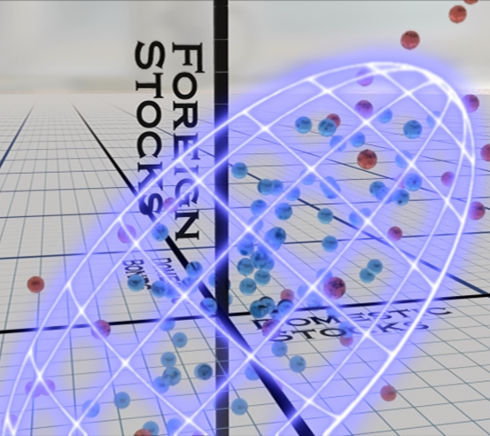
Measuring turbulence
Bonds
Bonds
Stocks
Stocks
Two uncorrelated assets with equal variance
Two correlated assets with different variances
Three correlated assets with different variances

Slide 13
Turbulence through history
Here, we measure turbulence across four global asset classes from a US dollar base.

Slide 14
Model portfolio allocation

Slide 15
Returns to risk are lower during turbulent periods

Slide 16
Case study: from theory to practice

Slide 17
Methodology*
Procure daily returns for each of the four asset classes in our model portfolio from January 2001 through December 2005.
Partition this data into the 20% most turbulent days and the 80% quieter days.
Create ten years of “synthetic” return observations by sampling (with replacement) from the turbulent and quiet samples with equal likelihood.
Perform a Full Scale Optimization on this synthetic sample with a kink in the utility function at an annual loss of 15%. We impose a constraint such that weights cannot differ by more than 10% from the model portfolio.
Compare the performance of the model portfolio and the FSO portfolio over the period from January 2006 through October 2010.
Determine how much return we are required to forfeit over the long term to increase our resilience during turbulent periods.
*Source: Kritzman, M. and Y. Li “Skulls, Financial Turbulence, and Risk Management.” The Financial Analysts Journal, May/June 2010.

Slide 18
FSO portfolio return - model portfolio return (annualized)

Slide 19
FSO portfolio allocation

Slide 20
Summary
We review mean-variance optimization and an evaluate its most common criticisms. MVO is more robust than conventional wisdom would have us believe.
We introduce Full Scale Optimization, which can be employed when investors are concerned about particular loss thresholds and/or when returns are fat tailed.
Using a simple model portfolio as an illustration, we show how investment returns can differ significantly during turbulent periods relative to the full sample average. Long term averages can lull investors into a false sense of security!
We employ FSO to construct a portfolio that is expected to be more resilient to market turbulence. We use data from 2001 through 2005 to construct this portfolio.
We measure the full sample performance (cost) and turbulent sample performance (gain) of the FSO portfolio over the period from 2006 through 2010.
By reallocating 20% of the portfolio, we find that we can enhance performance by 10% per year during turbulent periods at a long term cost of 1% per year.

